Slide 1

Car sales predication
Karthikeyan K and Sri Hari K V

Slide 2

Agenda
Why car sales prediction?
Dataset
Preprocessing data and EDA
Feature engineering
Building model and hyper param tuning
Deployment

Slide 3

Why car sales prediction?
More middle class in India
cars – standard of living
Economist – second hand cars
Increase in second hand car industry
price of second hand car – No proper methods
Car sales predictor

Slide 4

Dataset
https://www.kaggle.com/nehalbirla/vehicle-dataset-from-cardekho
This dataset contains information about used cars from cardekho
name
year
selling_price
km_driven
fuel
seller_type
transmission
Owner

Slide 5

Preprocessing data and EDA
Null values
no null values
Visualize multicollinearity
No multicollinearity
Visualize correlation
Healthy correlation between target
and variable

Slide 6

Feature engineering
Converted year of purchase to no of years
Provides more meaning to data
Remove car name
Unique values
Encoding categorical data
Helps ML model to learn better
(rejects object)

Slide 7

Building model and hyper param tuning
split into `train and test` data - 0.8:0.2
Randomized Search CV
Number of trees in random forest
Number of features to consider at every split
Maximum number of levels in tree
Minimum number of samples required to split a node
Minimum number of samples required at each leaf node
Model can find Best combinations

Slide 8
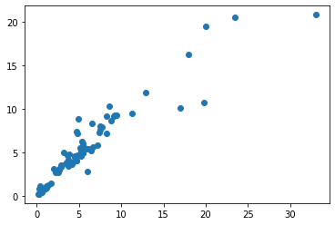
Result
MAE: 0.8849978021977988
MSE: 3.9544237722813156
RMSE: 1.9885733007061408

Slide 9

Deployment
Saved model and developed API using flask python
This Application is Deployed in Heroku Platform.
To Run this App use https://carprice--predic.herokuapp.com/

Slide 10


